Slide 1



How to scale down and not get caught
Optimizing the
Unreal Engine 4
"Rivalry" Demo
Martin.Mittring@EpicGames.com
Notes:
Title:
“How to scale down and not get caught - the Unreal Engine 4 "Rivalry" Demo”
Summary (<500 words):
Modern mobile graphics hardware is now able to run all features that were formerly exclusive to high end PC hardware and game consoles. With the Tegra K1 from NVIDIA we not only have the features but also the performance to run PC content.
For the Google IO 2014 Epic and NVIDIA together worked on a demo called: Unreal Engine 4 "Rivalry" Demo”. In a short amount of time we created the demo and managed to run it on the target hardware. In order to achieve 30fps we had to optimize code and content.
In talk we will show how we identified, optimized, scaled down features and adjusted content to run fast enough. To identify performance cost we only used the in engine profiling features for CPU and GPU. We used the in engine scalability functionality to
reduce cost where it only had minor impact. We iterated on the content and did code adjustments where appropriate. A similar process is needed for any real-time application as hardware will always be pushed to its limits by the content creators.
Although the demo was developed for the Tegra K1 the information in this talk is mostly hardware agnostic.
http://www.anandtech.com/show/8214/nvidia-and-epic-games-showcase-the-power-of-tegra-k1-with-unreal-engine-4-rivalry-demo

Slide 2
Overview
Demo / Video
How to profile effectively
Frames Per Second / Unit Graph / FPS Chart
Stats
Profile CPU/GPU time
Engine Show flags / View Modes
Features
Scalability
Console variables
INI files
[ Bonus slides ]
Notes:
"Through our close collaboration with NVIDIA, Epic's Unreal Engine 4 'Rivalry' project demonstrated at Google I/O shows what's possible when PC-class gaming technologies and performance are brought to mobile devices. In less than three weeks we were able to port content built for high-end PC and the DirectX 11 graphics API to Android and Google's AEP (Android Expansion Pack) extensions for ES 3.1. Developers can deliver incredible graphical complexity on a mobile chipset thanks to Tegra K1 and AEP." Tim Sweeney

Slide 3
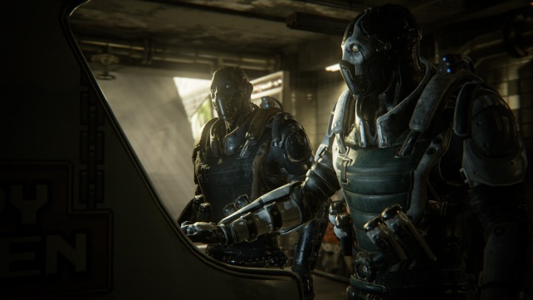
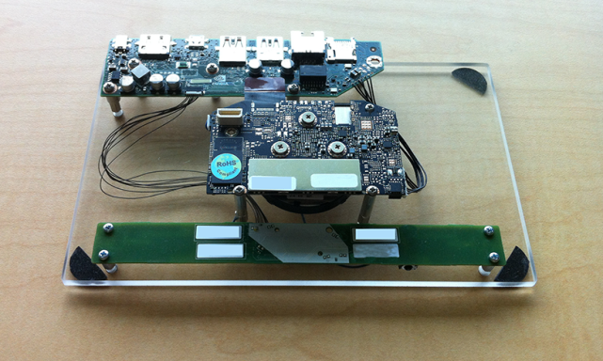
The “Rivalry” demo
3.5 week production for Google I/O 2014
OpenGL ES 3.1 with new extensions (~DX11 + ASTC)
Started from “Reflections subway”, characters from “Samaritan”
Had to change the fight scene to make it less violent
Art / Audio: 2-3 animators, 2 artists
Code: 1-3 engineers, 1-2+ engineers from NVIDIA with support
Running on early hardware / OS:
Android with NVIDIA Tegra K1
Crashes, hangs, stalls, no “Debug”, up-clock,
GPU Timer queries, driver perf. issues, audio
Notes:
Features used: Material layers, Screen Space Reflections, Deferred Shading, Scene Color Fringe, Tessellation, Real-time dynamic and stationary shadows, Baked indirect lighting, Environment Reflections, GPU particles, Physical based lighting, Depth of Field (Gaussian), Motion Blur, …
ASTC: Like DXT a texture compression format, often not present on PC GPUs but a good choice for mobile
Had to change the fight scene to make it less violent: Tim Sweeney found a good solution.
Art: 1 day Motion Capture, cleanup not in house
NVIDIA: 1-2+ engineers, direct connection to driver team
up-clock: NVIDIA found the device was not using the right clock rate and after that got fixed with a workaround and later with a driver we got free performance >10%
Crashes, hangs, no “Debug”, stalls -> overall a smooth ride
Full project - 5/28 to 6/20 = 3.5 calendar weeks:
Layout work by 2 people – 2 days (8 Hours) = 32 hours
Camera tweaks, lighting, and post polish – 3 day by one person = 24 hours
Audio sweetening and mix – maybe 3 days total (could be more).
One Mocap session - 6/6 = 12 man hours (3xPeople - 4 hour session)
Clean-up - 6/9 to 6/11 = 24 man hours (1xPerson)
Custom Animations - 6/11 to 6/17 = 56+ man hours on animation only (ScottD)
-> ~100+ h

Slide 4
Demo / Video
http://youtu.be/HY62PAsM7eg

Slide 5
The hardware spectrum
PC / Mac
(integrated / dedicated GPU, x cores, x memory, features)
Phone / Tablet
(x cores, x memory, features)
High end
(fast)
UE4: Forward Renderer
(ES2, Metal)
UE4: Deferred Renderer
(Direct3D, OpenGL, ES3.1)
Shading consistent with Deferred
4 performance tiers:
LDR, Basic, HDR, HDR with per pixel sun
Dynamic/Static per pixel HDR lighting
Many lights/reflection probes
Motion Blur, TemporalAA, SSAO, SSR, Deferred Decals, …
Notes:
Low end Phone: can be older, more battery saving or cheaper
Low end PC: can be older, more battery saving or cheaper, integrated graphics
Green dot: That small overlap is where we see the Tegra K1 appearing, for this demo we chose the more feature rich deferred renderer path.
Left side: you see we cannot catch all hardware – it’s just not possible – the performance level of (speciallly) older phones is just too low. UE3 might be an option for some but you will miss the UE4 features
Right side: We still have some room as it’s easy to scale up some feature e.g. resolution, object count
UE3 also had some mobile specific code path, aiming a bit lower and sharing most with the PC (non deferred path), the

Slide 6
How to profile effectively
Prepare the right conditions:
  Never in “Debug”, “Development” is convenient, “Test” is gives near “Shipping” fps
  Not in editor (Slate UI renders each frame, some Thumbnails get updated irregularly, …)
  Make sure lighting has been built
  Avoid procedural randomness* (particles, procedural levels, game play)
iterate
Stabilize and Isolate:
  “Pause”, “r.AllowOcclusionQueries 0”, “Slomo 0.001”, …
  Command line options: -NoSound -NoTextureStreaming -NoVSync -NoVerifyGC
  Disable other features, look for log spam, create a matinee
Experiment and Measure (to identify the bottleneck):
  “r.SetRes”, “r.SceneColorFormat”, “showflag bloom”, …
  Modify shaders, recompile (“Ctrl Shift .”)
Notes:
effectively: Profiling can give you a lot of data but you want to find the actionable items in a short amount of time, this is an iterative process and needs to be repeated when bigger things have changed
BTW: When I say console I usually mean the in-game console you can open with a keypress (~) or the in editor OutputLog –both can be used to interact with console commands/variables

Slide 7
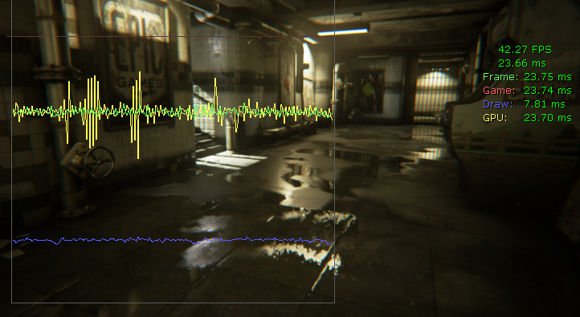
Frames Per Second / Unit Graph
Always start here
“Stat Unit / UnitGraph / Detailed”
Look for unstable FrameTime / Hitches, use “Stat Raw” to disable smoothing
Communicate delta in ms, avoid fps
Notes:
We start with the simple most trustable number: fps
Modern hardware has many units that run in parallel (e.g. GPU: memory, triangle/vertex/pixel processing, etc. and CPU: multiple CPUs, memory, etc.). Often those units need to wait on each other. You first need to identify what you are bound by. Optimizing that is likely to improve performance. Optimizing the wrong thing is a waste of time and is likely to introduce new bugs or even performance regressions in other cases. Once you improved that area, it is often good to profile again as this might reveal a new performance bottleneck that was formerly hidden.
First you should check if you frame rate is limited by CPU or the GPU cost. As always you either can vary the workload (e.g. change the resolution) and see what has effect. Here it is easier to look at the engine build in feature stat unit.

Slide 8
What I am bound by?
What “FrameTime” can be limited by:
  “Game” is CPU time on main thread
  “Draw” is CPU time on render thread
  “GPU” is GPU time
  VSync
  Max Tick rate
  (e.g. t.MaxFPS, SmoothFrameRate=true, r.DontLimitOnBattery)
“Game” can show GPU time as we sync with GPU (more steady fps, back buffer not available yet)
Notes:
The actual frame time is limited by one of the three: Game (GPU game thread), Draw (GPU render thread) or GPU (GPU). Here we can see the GPU is the limiting factor (the largest of the three). In order to get a smaller Frame time we have to optimize the GPU workload there.

Slide 9
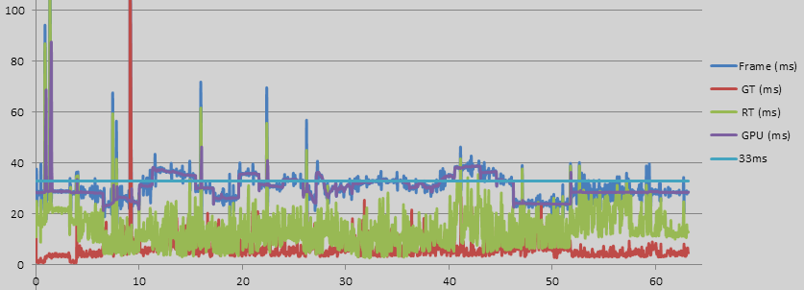
FPSChart
Very valuable to track progress (hitches, where < target fps)
“StartFPSChart” “EndFPSChart”
Open .csv file in Excel
Create “Scatter With Straight Lines” starting with line 5
Notes:
Last thing said: don’t use fps, next slide we already break the rule, FPSChart is a bad name as it doesn’t show fps
It can be very useful to get the stat unit times over a longer period of time (e.g. in-game cutscene or a camera path set up to test many cases).
The following chart was generated on an Android device (Streaming) from a cutscene. Before and after the cutscene the console commands StartFPSChart and EndFPSChart were entered. The resuling .csv file (in [ProjectFolder]\Saved\Cooked\Android_ES31\SubwayPatrol\Saved\Profiling\FPSChartStats) was opened in Microsoft Excel. For this example we removed the first 4 header lines, selected all, and inserted a Scatter With Straight Lines plot.

Slide 10
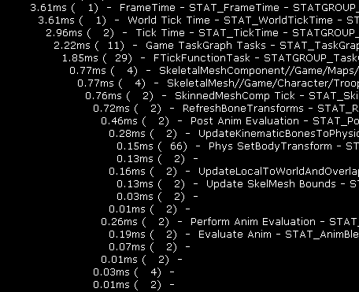
Profile CPU time
Runtime: “Stat DumpFrame –ms=.1”
Log/Console hierarchy of sections slower than 0.1ms
“QUICK_SCOPE_CYCLE_COUNTER(MyOwnProfilerName)”
Annotate code to drill deeper
Offline / Remote: “Stat StartFile / StopFile”
browse with UFE like Stats
Notes:
Other tools e.g.
“NVIDIA Tegra System Profiler”
or “VTune”

Slide 11
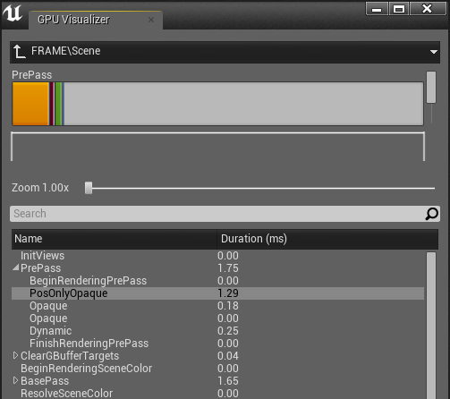
Profile GPU time
“Ctrl Shift ,” or “ProfileGPU”
  Not always trustable (based on Timer queries):
  Mac OpenGL doesn’t have “Duration”
  Driver can optimize deferred
  (wait after load or shader change)
  Noise (measure multiple times)
  Cost can leak to other passes
  e.g. Compute Shaders
Notes:
Mac doesn’t show “Duration”: (OpenGL version there misses timer queries)
Text output includes draw call count
If possible (not on console) UI pops up unless disabled with “RHI.ShowProfilerAfterProfilingGPU”
Other tools e.g.
“NVIDIA Tegra Graphics Debugger”

Slide 12
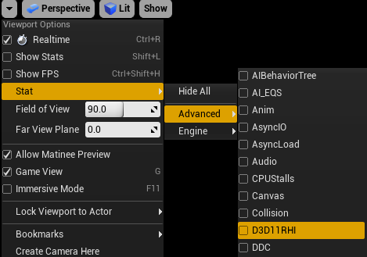
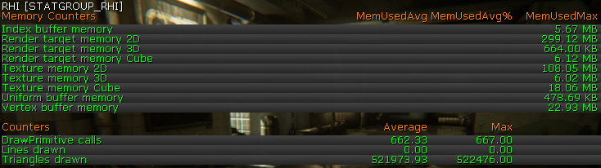
Stats (internal counters)
Runtime: “Stat RHI / D3D11RHI / InitViews / Game / Memory / SceneRendering / …”
Offline / Remote: “Stat StartFile / StopFile” to record .ue4stats file
browse with UnrealFrontEnd (UFE)
Notes:
UFE also can do live connection
Use external tool to browse UFE (replaces UE3 StatsViewer)

Slide 13
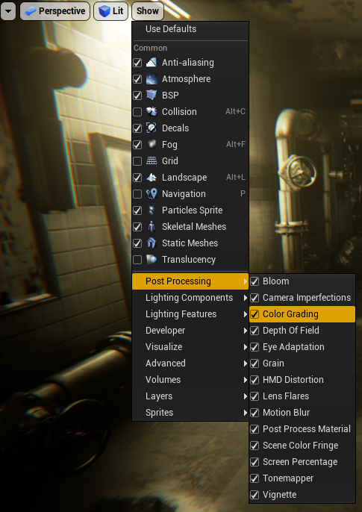
Engine Show flags
128+, easy to add, per viewport
Can be compiled to 0 or 1 in shipping
Toggle features, enable debug views*
Narrow down, check visual impact,
profile delta
User input | Function
Show | Dump all with state
Show Bloom | Toggle feature in game
Showflag.Bloom 0/1/2 | Force feature on/off (cvar, can be put into consolevariables.ini)
Notes:
toggle features -> eval bang for the buck
*: created VisualizeSSR to see where the masking requires the expensive processing (see bonus slides)
The engine show flags can be used to toggle a lot of rendering features. The editor lists all show flags in a convenient 2D UI. You can click on the checkbox to toggle multiple checkboxes without closing the menu.
In-game, you can use the show command. Use show to get a list of all show flags and their state. Use show showflagname to toggle a feature. Note that this only works in game viewports, so in editor viewports, the editor UI needs to be used. You can use the console variables (e.g. showflag.Bloom) to override show flag values in-game or in the editor, but that also disables the UI.
A good profiling starting point is with high-level features, such as show StaticMeshes or show tesselation.
All show flags are also exposed as console variables, e.g. console show Bloom, showflag.Bloom 0 or in configuration files: showflag.Bloom = 0Console variables require more typing but they also override the editor UI showflags and they can be put into configuration files like other console variables.

Slide 14
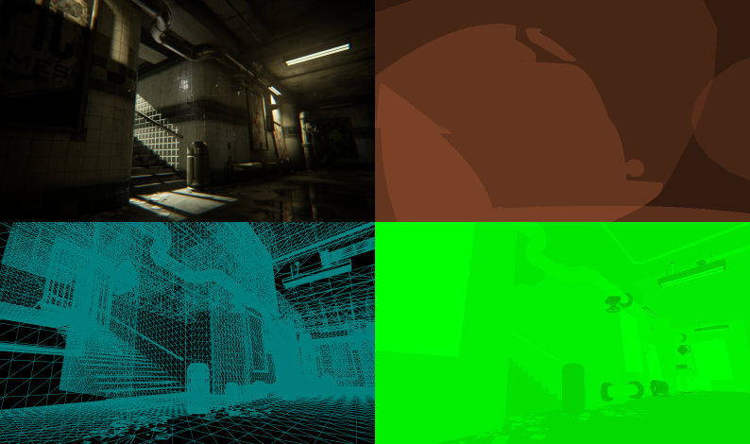
View modes
Just a Engine Show Flag combination
Editor UI
“ViewMode Lit / Wireframe / …”
Lit
Wireframe*
Shader Complexity*
Light Complexity*
Notes:
Wireframe helped to identify expensive water splash meshes, tessellated walls stayed as it would have been too much work to replace the vertex colors with a texture
LightComplexity was very useful to reduce the cost of lights: smaller attenuation radius, smaller cone angle, see which lights are enabled but barely visible
ShaderComplexity helped to focus attention on large overdraw and expensive materials

Slide 15
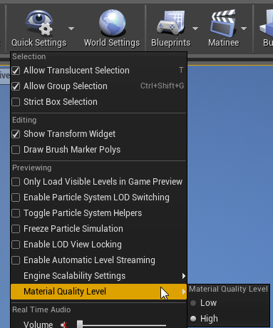
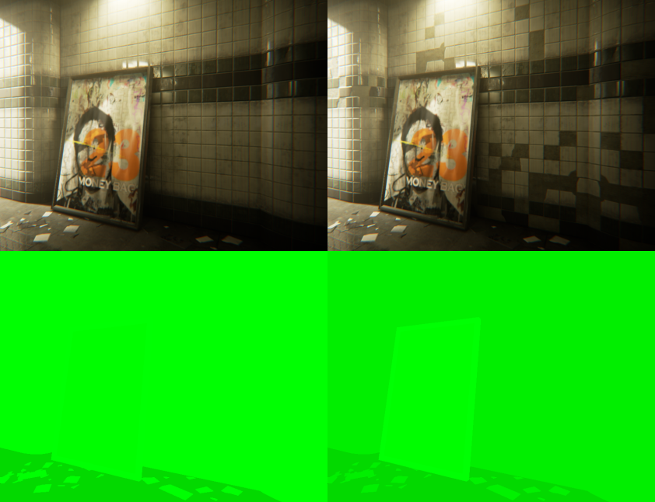
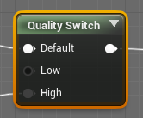
Features 1/x
Each Feature has performance / memory / quality characteristics,
depend on hardware, interact with other features
Material System: Static switch and “r.MaterialQualityLevel”
can result in shader permutation, multiple shader stages, …
Low quality
High quality
Shader Complexity
(faster)
Shader Complexity (slower)
Notes:
UE4 has a lot of features with complex interactions affecting performance, much more than can be covered here. The next few slides cover a few larger features and mention their basic performance characteristic.
I will did deeper in a few cases but those slides are more meant for reference. Having this is knowledge about the feature you care is important.
* We did disable tiled and reduced the deferred light/reflection count (single box reflection probe, aligned to the world geometry)
* Reducing attenuation radius and cone size helped, disable shadow casting lights as well
* We replaced many sphere reflection probes with a single box probe
* Reflections use baked indirect light lighting which is range limited: Because all content was very dark the limited range and quantization caused the reflections to be very dark – we had to fix the content

Slide 16

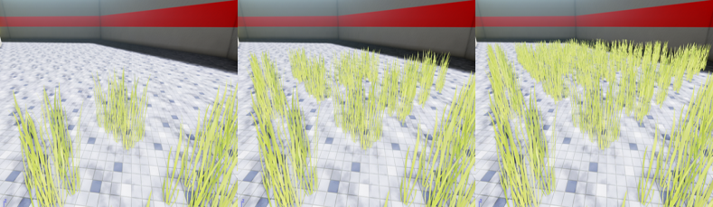
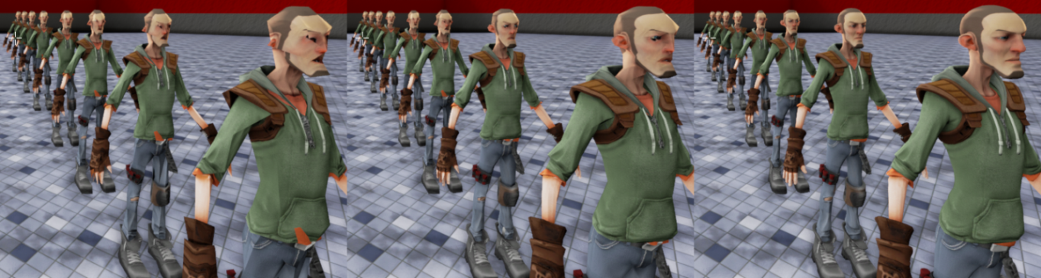
Features 2/x
low
med
high
“r.Detail Mode” (low/med/high):
Object / Particle property,
can reduce vertex / triangle cost on GPU,
can reduce GPU Pixel cost (Quad utilization),
less materials,
simpler materials can reduce CPU cost
Mesh LOD: “r.SkeletalMeshLODBias”, can reduce vertex/triangle cost on GPU, Can reduce GPU Pixel cost (Quad utilization),
less materials / simpler
materials can reduce
CPU cost
low
med
high
LOD Bias 2
slower
LOD Bias 1
LOD Bias 0
Notes:
UE4 has a lot of features with complex interactions affecting performance, much more than can be covered here. The next few slides cover a few larger features and mention their basic performance characteristic.
I will did deeper in a few cases but those slides are more meant for reference. Having this is knowledge about the feature you care is important.
* We did disable tiled and reduced the deferred light/reflection count (single box reflection probe, aligned to the world geometry)
* Reducing attenuation radius and cone size helped, disable shadow casting lights as well
* We replaced many sphere reflection probes with a single box probe
* Reflections use baked indirect light lighting which is range limited: Because all content was very dark the limited range and quantization caused the reflections to be very dark – we had to fix the content

Slide 17

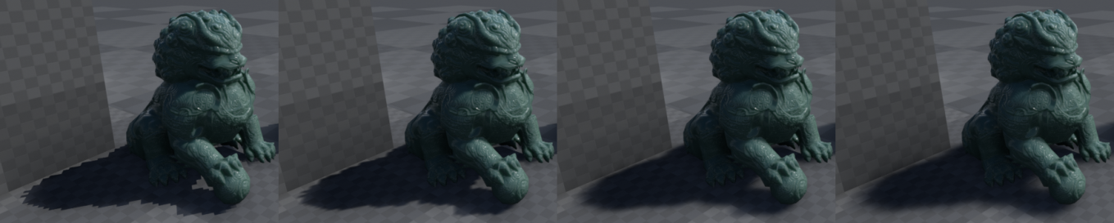
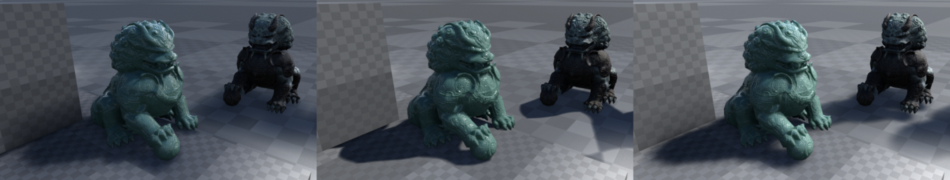
Features 3/x
Shadow map rendering: GPU scales with shadow map size, Omni
costs extra, CPU scales with object and cascade count, memory is reused
Shadow filtering: GPU scales with sample count (“r.ShadowQuality”) and affected pixel count*
Light types: “Static” is free with baked lighting, “Stationary” bake static mesh shadows,
Shadows cost extra, Reflections use baked indirect light lighting which is range limited*
Shadow map
1
2
3
4
Static
(approx. spec)
Stationary (DistanceField)
Dynamic
Notes:
UE4 has a lot of features with complex interactions affecting performance, much more than can be covered here. The next few slides cover a few larger features and mention their basic performance characteristic.
I will did deeper in a few cases but those slides are more meant for reference. Having this is knowledge about the feature you care is important.
* We did disable tiled and reduced the deferred light/reflection count (single box reflection probe, aligned to the world geometry)
* Reducing attenuation radius and cone size helped, disable shadow casting lights as well
* We replaced many sphere reflection probes with a single box probe
* Reflections use baked indirect light lighting which is range limited: Because all content was very dark the limited range and quantization caused the reflections to be very dark – we had to fix the content

Slide 18
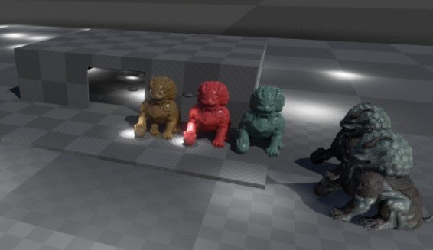


Features 4/x
Deferred (reflections, lighting, decals, light functions):
GPU cost scales with affected screen size*,
overlapping areas cost extra*, extra stencil pass can help
Tiled deferred (reflections, lighting):
Only faster with many objects, some restrictions, can use non tiled*
“r.TiledDeferredShading”,
“r.TiledDeferredShading.MinimumCount”,
“r.NoTiledReflections“ (not yet exposed)
Lit
LightComplexity: NonTiled
LightComplexity: Tiled
Notes:
UE4 has a lot of features with complex interactions affecting performance, much more than can be covered here. The next few slides cover a few larger features and mention their basic performance characteristic.
I will did deeper in a few cases but those slides are more meant for reference. Having this is knowledge about the feature you care is important.
* We did disable tiled and reduced the deferred light/reflection count (single box reflection probe, aligned to the world geometry)
* Reducing attenuation radius and cone size helped, disable shadow casting lights as well
* We replaced many sphere reflection probes with a single box probe
* Reflections use baked indirect light lighting which is range limited: Because all content was very dark the limited range and quantization caused the reflections to be very dark – we had to fix the content

Slide 19
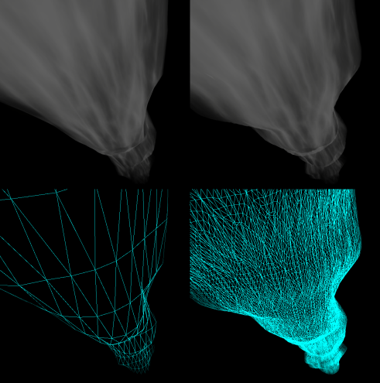

Features 5/x
Tessellation: Compiled in the shader (no Tessellation is faster),
show flag sets Tess-factor to 0
Particles: CPU cost for spawning and CPU simulation,
GPU particles have CPU spawn cost,
Mesh instancing if hardware supports it,
GPU cost scales with covered screen size,
Show flag disables rendering,
update can be disabled with “fx.FreezeParticleSimulation”
Notes:
* We did disable it for the demo
ScreenPercentage: TemporalAA and good upsampling helps the quality
Wasn’t used in the demo

Slide 20

Features 6/x
SeparateTranslucency: 64bit RT and resolve pass
but 32bit HDR with faint translucency has quality problems
“r.SeparateTranslucency 0” to disable*
Screen Percentage: Render 3D in lower resolution, extra upsample pass
“r.ScreenPercentage” / PostProcessSettings / WindowedFullscreen
e.g. 80 results in only 80*0.8% pixels, affected by “r.SceneRenderTargetResizeMethod”
useful to test if pixel bound
Zoom in with varying “r.ScreenPercentage”
100
75
50
20
Notes:
* We did disable it for the demo
ScreenPercentage: TemporalAA and good upsampling helps the quality
Wasn’t used in the demo

Slide 21
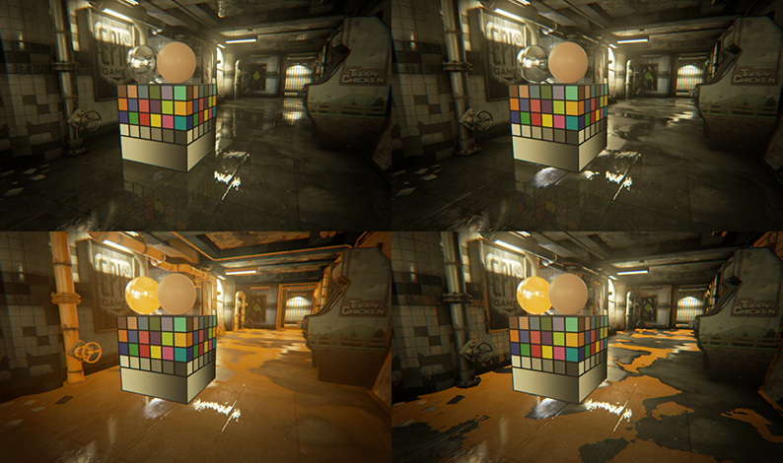
Features 7/x
Screen Space Reflections: Large GPU cost on pixel of low roughness, glossy method is more correct but noisy, “r.SSR.MaxRoughness” to override Post process setting*
r.SSR.MaxRoughness 0.9
r.SSR.MaxRoughness 0.1 (faster)
0.9, show VisualizeSSR
0.1, show VisualizeSSR

Slide 22
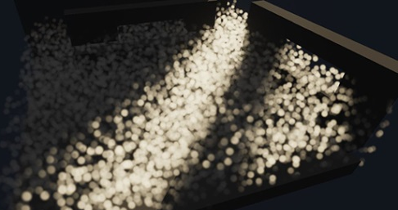
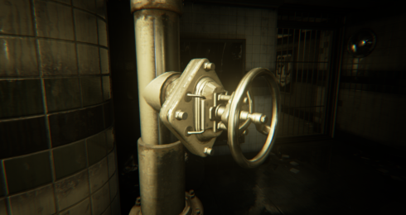

Features 8/x
Translucency Lighting Volume: GPU cost scales ^3 with resolution*,
limited size, approximates per pixel lighting, lighting with low
resolution can appear blocky or leak through walls
Occlusion Culling (Occlusion Query): GPU scales with object screen size,
CPU cost scales with object count, “uneven” distribution over frames
Occlusion Culling (HZB): Fixed base cost, low CPU and
GPU cost per object, more conservative with object screen size
still has some issues
HZB Mip6
HZB Mip5
HZB Mip4
HZB Mip3
HZB Mip2
HZB Mip1
Notes:
* Lowered the resolution, disabled blur, was no issue with demo content

Slide 23
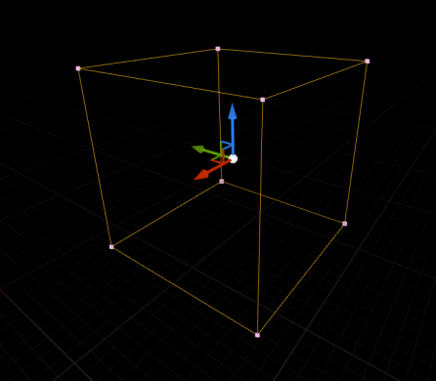
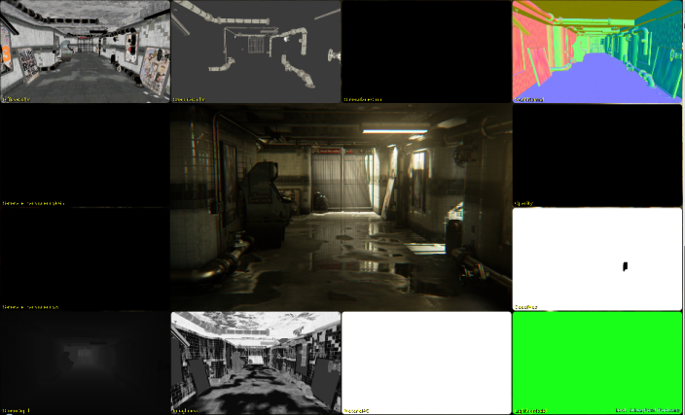
Features 9/x
Post Process Settings: Multiple volume get blended (lerp in priority order,
using weight and property checkbox as mask), if not unbound checkbox is
not set the weight is computed with camera distance to the volume and
the blend radius
PostProcess Materials: Full screen pass not combined withother passes,
“Before/After Tone mapper” affects interaction with TemporalAA also performance and look,
“Material Instance Params” get blended on CPU to a single
full screen pass
Notes:
Lerp: linear interpolation (like default photoshop layer blending)
* We actually disabled the LUT lookup for this demo
“…”: could go on for a while, could be more in detail, actual information changes when we update features, depends on hardware, read UDN docs about specific features, …
BufferVisualization is actually using mutliple postprocess materials – this way you can make your own BufferVisualization

Slide 24
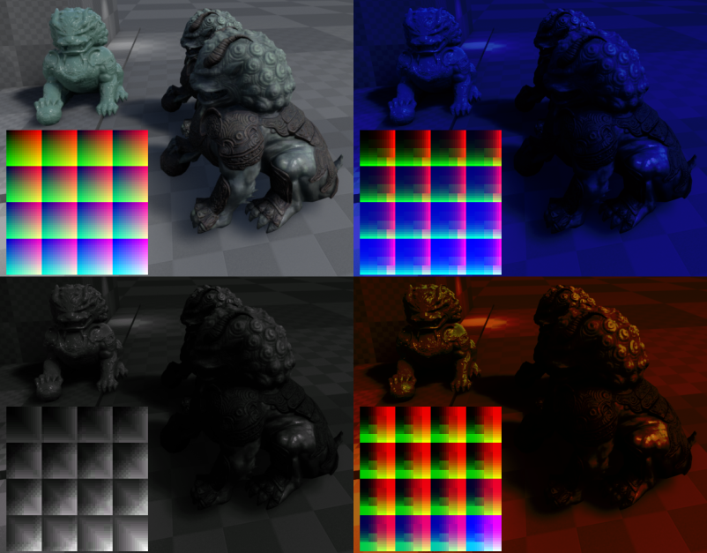
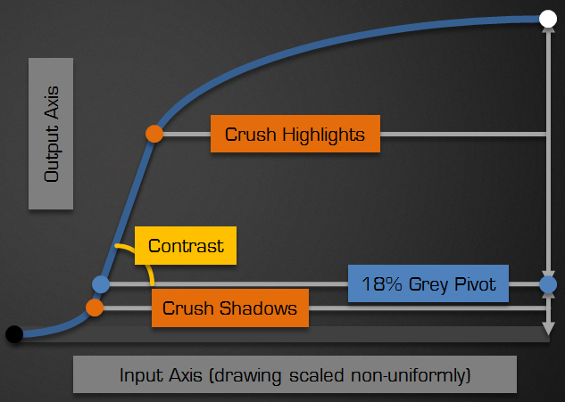
Features 10/x
ColorGrading (LUT): Up to 4 16x16x16 textures can blended into a single LUT, blending is very fast, Final LUT is applied in Tone mapper pass*, Since recently optimized out if not needed,
New tone mapper offers some flexibility and is faster
…
Notes:
Lerp: linear interpolation (like default photoshop layer blending)
* We actually disabled the LUT lookup for this demo
“…”: could go on for a while, could be more in detail, actual information changes when we update features, depends on hardware, read UDN docs about specific features, …

Slide 25
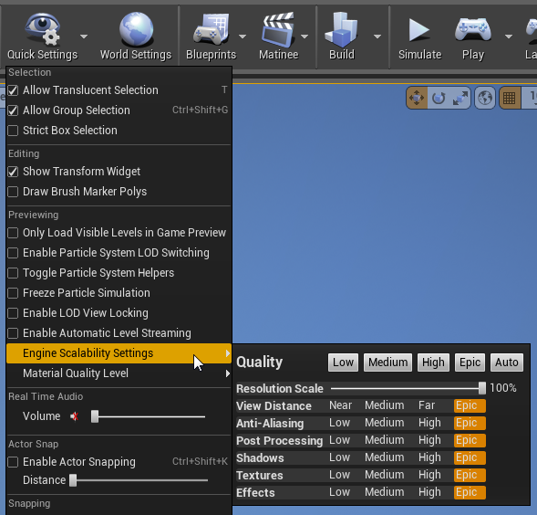
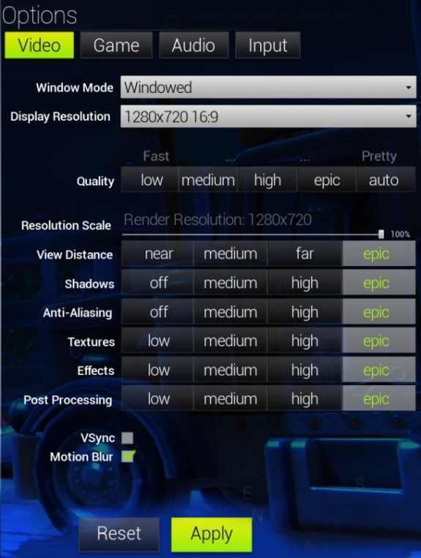
Scalability
In Editor UI
Fortnite WIP
Notes:
Left is WIP Fortnite, we might implement a engine options menu but a game specific will always be better, it can/should use the underlying scalability system
Right is in Editor UI

Slide 26
Scalability: Hierarchy
Engine defaults (project/game code specific) | Bloom, Tonemapper, EyeAdaptation, TemporalAA, SSAO, SSR, MotionBlur, …
Content (Art/Design controlled) | Lights / objects / materials, post process settings, …
~35 engine console variables | “r.FastBlurThreshold”, “r.MaxAnisotropy”, “r.DetailMode”, “UI.BlurRadius”, ...
~6 “sg.” console variables (scalability group) | “sg.Effects”, “sg.ShadowQuality”, …
1 console command | “Scalability”
Notes:
Engine defaults compromise to give people with low end machines a not too slow editor but also not hide all the high end features from people that never adjust the settings

Slide 27
Console Variables 101
Discover: “DumpConsoleCommands”, AutoCompletion
Typed: int / float / string / int& / float&
Flags: e.g. ECVF_Cheat (compiled out in Shipping)
GetValueOnRenderThread() / GetValueOnGameThread()
Expresses user wish (Don’t change by code, don’t store state)
Don’t query each frame, use “static” on the object pointer
Editor OutputLog or in game console | Function
CVarName ? | Get help text
CVarName | Get current state
CVarName <value> | Set value
Notes:
GetValueOnRenderThread() / GetValueOnGameThread(): We keep 2 copies of the value and propagate the change to the render thread so the value is consistent between the main and render thread[s].

Slide 28
ConsoleVariables.ini
Developer override*
Don’t use for shipping
Data driven (no recompile)
Applied on startup
; The name comparison is not case
; sensitive and if the variable
; doesn't exists it's silently
; ignored.
r.ShaderDevelopmentMode = 1
con.MinLogVerbosity = 10
;r.DumpShaderDebugInfo = 1
; comment lines with “;”
;r.DBuffer=1
Notes:
r.DumpShaderDebugInfo
When set to 1, will cause any shaders that are then compiled to dump debug info to GameName/Saved/ShaderDebugInfo
The debug info is platform dependent, but usually includes a preprocessed version of the shader source.
On iOS, if the PowerVR graphics SDK is installed to the default path, the PowerVR shader compiler will be called and errors will be reported during the cook.

Slide 29
[Base/Default]Scalability.ini
Defines actual settings of the options presented to the user
Data driven (no recompile)
Implemented as callback of
“sg.” console variables
Projects/Platforms can adjust
through directory override
[AntiAliasingQuality@0]
r.PostProcessAAQuality=0
r.MSAA.CompositingSampleCount=1
[AntiAliasingQuality@1]
r.PostProcessAAQuality=2
r.MSAA.CompositingSampleCount=1
[AntiAliasingQuality@2]
r.PostProcessAAQuality=3
r.MSAA.CompositingSampleCount=2
...

Slide 30
[Base/Default]DeviceProfiles.ini
Should restrict what settings need to be locked on that platform*
Multiple Projects/Platforms can
override through single file
Hierarchy through
[Name] and “BaseProfileName=“
[Android_TegraK1 DeviceProfile]
; remove settings from higher up
-CVars = r.RefractionQuality=0
-CVars = r.DepthOfFieldQuality=0
; add new settings
+CVars = sg.ShadowQuality=2
+CVars = r.SeparateTranslucency=0
+CVars = r.PostProcessAAQuality=3
[Windows DeviceProfile]
; to preview on windows
BaseProfileName=Android_TegraK1
Notes:
* Was used to override settings, often artists later fixed the content so we removed it again

Slide 31
Bonus Slides

Slide 32
Target the specific content and platform
Feature | Visual impact in that demo (Bang) | Cost on that hardware in that demo (Buck) | Choice for that demo
EarlyZ Pass | 0 | Makes it faster | Enabled
Separate Translucency | Low | Ok | disabled
Shadow Quality | Some | High | Medium setting
Bloom | High | Ok | Medium setting
SSAO | low | High on that hardware | disabled
Sun shafts | low | Ok | No used
Translucency lighting | low | High | Low setting
Tiled Lighting/Reflections | 0 | High (simple content) | Use non tiled
Screen Space Reflections | High (wet surfaces) | High but adjustable | Tweaked per shot, no roughness
TemporalAA | High with HDR | Ok | Slightly lower setting
ColorGrading | 0 if not used | High | Film only, disabled LUT
Depth of Field | High | Ok .. High | Small Gaussian, near DOF
Motion Blur | High | Ok | Selective shots
Scene Color Fringe | Medium | Ok (we optimized) | On (Art style)
Notes:
Actual scalability settings heavily depend on the content (low occlusion, small view distance, few objects, closeups, cinematic, controlled camera, no 2D, …)
and platform (unified memory means less bandwidth, 720p, screen size, …)
SSR: Screen Space Reflections

Slide 33
CVar Settings used in the demo
r.SeparateTranslucency = 0
r.PostProcessAAQuality = 3
r.ShadowQuality = 2
r.AmbientOcclusionLevels = 0
r.Shadow.CSM.MaxCascades = 2
r.BloomQuality = 4
r.FastBlurThreshold = 2
r.TonemapperQuality = 0
r.MaxAnisotropy = 2
r.TranslucencyLightingVolumeDim = 24
r.TranslucencyVolumeBlur = 0
r.SSR.Quality = 1
r.TiledDeferredShading = 0
r.SceneColorFormat = 3
r.EarlyZPass = 2
r.NoTiledReflections = 1 (not yet exposed)
r.MotionBlurQuality = 2
r.MotionBlurSoftEdgeSize = 0.7
r.DepthOfFieldNearBlurSizeThreshold = 100
r.DepthOfField.MaxSize = 0.4
r.SceneColorFringe.Max = 0.7
r.MotionBlur.Scale = 0.6
r.MotionBlur.Max = 2
Notes:
From the ini:
+CVars = r.SeparateTranslucency=0
; the level is closed so we should not need to clear (crashs the device, we are on it, might not help performance)
;+CVars = r.ClearSceneMethod=0
; Slightly faster TemporalAA
+CVars = r.PostProcessAAQuality=3
; no soft transition between cascades for directional light
+CVars = r.Shadow.CSM.TransitionScale=0
;lower shadow filter quality
+CVars = r.ShadowQuality=2
; saves quite a bit and artist cannot even see it with their current build
+CVars = r.AmbientOcclusionLevels=0
; fewer cascades
+CVars = r.Shadow.CSM.MaxCascades=2
; faster lower quality bloom
+CVars = r.BloomQuality=4
; faster lower quality bloom
+CVars = r.FastBlurThreshold=2
; less sharp upsampling, not used yet, might not be worth it
+CVars = r.UpsampleQuality=2
; no color quantization, maybe we can even output 10:10:10
+CVars = r.TonemapperQuality=0
; lower quality texture filtering quality
+CVars = r.MaxAnisotropy=2
; lower quality translucency lighting (larger blocks)
+CVars = r.TranslucencyLightingVolumeDim=24
; lower quality translucency lighting (more box shape artifacts)
+CVars = r.TranslucencyVolumeBlur=0
; less screen space reflection sample count (more noise) 1 and 2 are not taking roughness into account
+CVars = r.SSR.Quality=1
; at 720p we better better not blur further
;+CVars = r.ScreenPercentage=90
; maybe later we optimize or disable that feature
;+CVars = r.SceneColorFringeQuality=0
; disable tile deferred lights (GPU particle lights) as the cost is too high on that device
+CVars = r.TiledDeferredShading=0
; less precise HDR scene color format (on ES3.1 we only can use the 32bit format if we disable tile based passes as ComputeShaders cannto write to 32bit HDR format)
+CVars = r.SceneColorFormat=3
; to save bandwidth, no visual difference, when characters large on the screen it can save ~7ms, use "vis SceneDepth@0" to visualize
+CVars = r.EarlyZPass=2
; Turn off tiled reflections in favor of SM4-style reflections
+CVars = r.NoTiledReflections=1
; lower quality motionblur (less samples)
+CVars = r.MotionBlurQuality=2
;minor impact on performance and like little impact on look
+CVars = r.MotionBlurSoftEdgeSize=0.7
; disable near Gaussian DOF (ensures we have only one layer DOF)
+CVars = r.DepthOfFieldNearBlurSizeThreshold=100
; slightly smaller than artist content setup for better performance
+CVars = r.DepthOfField.MaxSize=0.4
; looks better, tweaked for 720p, could have been done in content or we should limit to have 1 pixel at max
+CVars = r.SceneColorFringe.Max=0.7
; less strong in extreme motion, still barely clamped
+CVars = r.MotionBlur.Scale=0.6
; less separate image effect and slightly faster
+CVars = r.MotionBlur.Max=2
; better quality, can change in content later if needed (so far 0.1 for better performance)
;+CVars = r.SSR.MaxRoughness=0.5

Slide 34
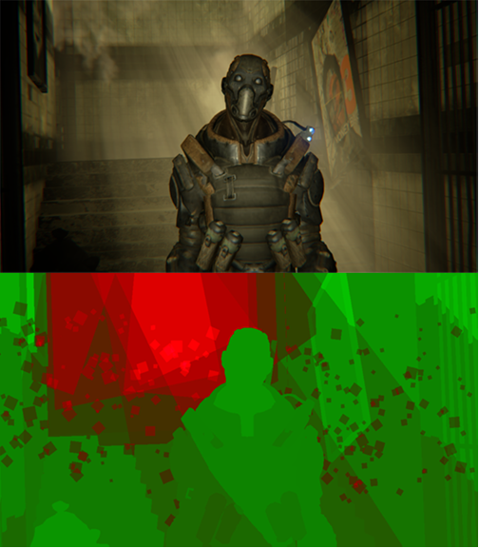
Content feedback 1/3
Notes:
This scene is quite heavy – it’s the worst of all shots, I noticed small particles that cost but seem to have no visual.
The scene is mostly expensive due to the lighting (many lights covering large of the screen) and the light shafts shader.

Slide 35
Content feedback 2/3
High poly refractive translucency
Tesselated walls
(used for vertex colors)

Slide 36
Content feedback 3/3
Skybox material (on occluded mesh)

Slide 37
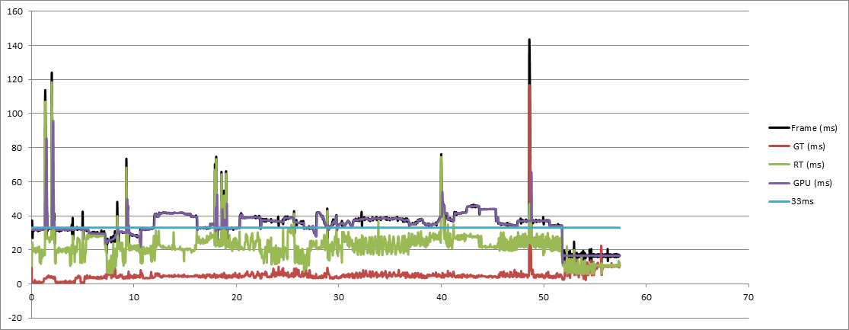
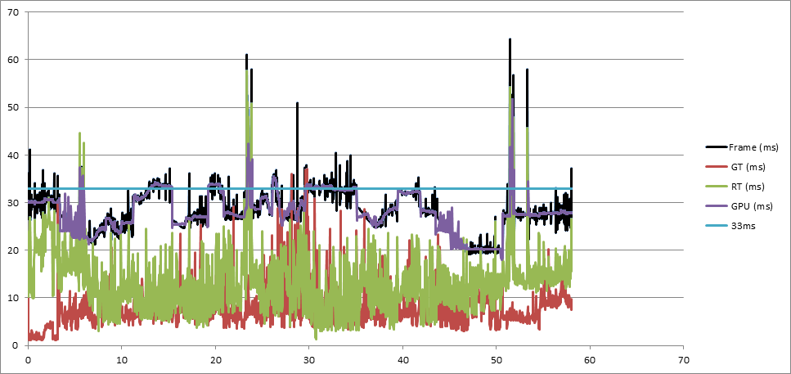
FPS Charts
B
A:
A: Where we started
huge spikes,
no final content,
many areas >33ms
B: Near the end (not final)
with Depth Of Field,
with Motion Blur,
remaining spikes (driver?),
some areas are too close
B:

Slide 38
Thanks
Evan Hart from NVIDIA, NVIDIA
Daniel Lamb, Niklas Smedberg (Smedis), Timothy Lottes, Rendering team
More info (UDN pages):
PerformanceProfiling.INT
PerformanceGuidelines.INT
ScalabilityAndYou.INT
ScalabilityReference.INT
Options.INT
MobilePerformance.INT
“UE4 Mobile Performance” Niklas Smedberg, West Coast Dev Tour 2014

Slide 39


UE4 Questions?
Documentation, Tutorials and Help at:
AnswerHub:
Engine Documentation:
Official Forums:
Community Wiki:
YouTube Videos:
Community IRC:
Unreal Engine 4 Roadmap
lmgtfy.com/?q=Unreal+engine+Trello+
http://answers.unrealengine.com
http://docs.unrealengine.com
http://forums.unrealengine.com
http://wiki.unrealengine.com
http://www.youtube.com/user/UnrealDevelopmentKit
#unrealengine on FreeNode

Slide 40


